Slide 2
Biologically inspired algorithms Exercise 6
Ing. Lenka Skanderová, Ph. D.

Slide 3
Content
Particle Swarm Optimization (PSO)

Slide 4
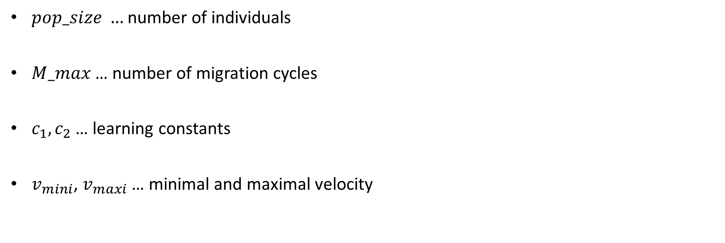
PSO – Control Parameters
$pop_size …$number of individuals
$M_max$ … number of migration cycles
$c_{1}, c_{2}$ … learning constants
$v_{mini}$, $v_{maxi}$ … minimal and maximal velocity

Slide 5
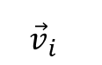
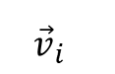
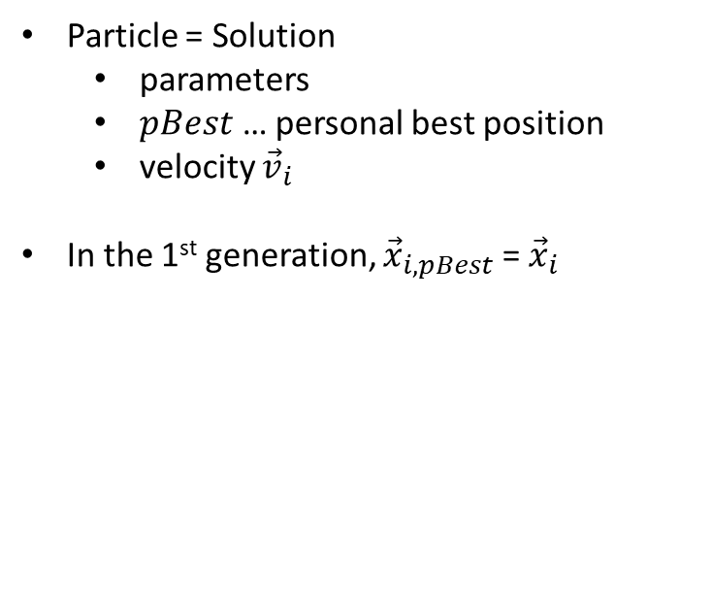
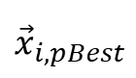
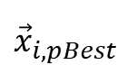
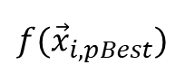
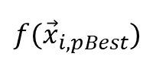
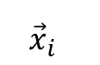
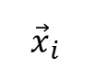
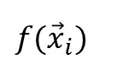
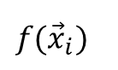
PSO – Particle
Individual – 1st generation
Individual – next generations
Particle = Solution
parameters
$pBest$ … personal best position
velocity ${\vec{v}}_{i}$
In the 1st generation, ${\vec{x}}_{i,pBest}$ = ${\vec{x}}_{i}$
$${\vec{x}}_{i}$$
$${\vec{v}}_{i}$$
$${\vec{x}}_{i,pBest}$$
$${\vec{x}}_{i}$$
$${\vec{v}}_{i}$$
$${\vec{x}}_{i,pBest}$$
3.4
0.3
3.4
5.2
0.9
3.4
2.5
-1.2
2.5
2.5
1.2
2.5
1.0
0.6
1.0
7.6
0.4
1.0
5.0
1.0
5.0
4.8
0.0
5.0
2.2
-0.8
2.2
10.2
-0.5
2.2
48.65
48.65
104.04
48.65
$$f({\vec{x}}_{i})$$
$$f({\vec{x}}_{i,pBest})$$
$$f({\vec{x}}_{i})$$
$$f({\vec{x}}_{i,pBest})$$
Position of a particle changes regardless the evaluation of the objective function

Slide 6
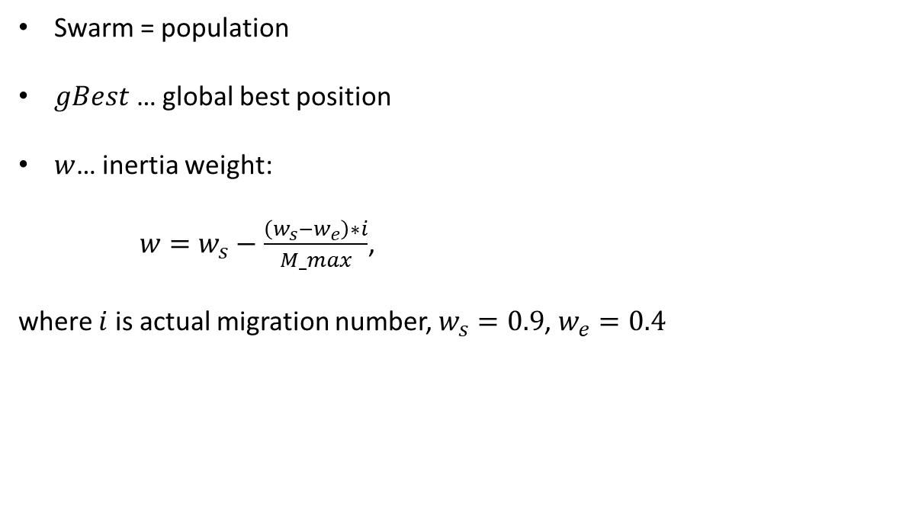
PSO – Swarm
Swarm = population
$gBest$ … global best position
$w$… inertia weight:
$w=w_{s}−\frac{\left(w_{s}−w_{e}\right)∗i}{M_max}$,
where $i$ is actual migration number, $w_{s}=0.9$, $w_{e}=0.4$

Slide 7
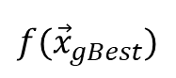
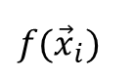
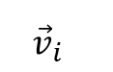
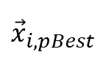
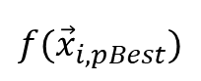
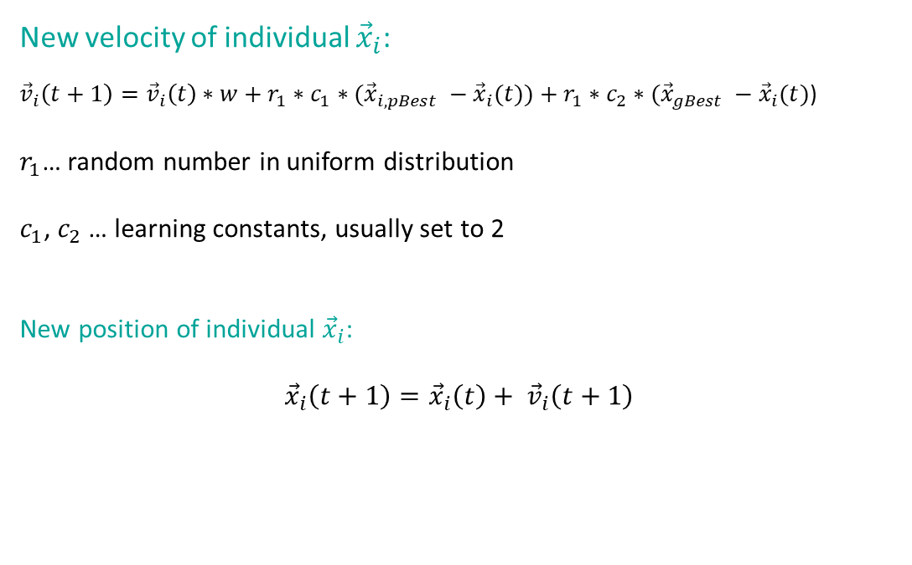
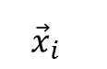
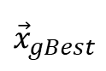
PSO – Particle motion
$${\vec{x}}_{i}$$
$${\vec{v}}_{i}$$
$${\vec{x}}_{i,pBest}$$
$${\vec{x}}_{gBest}$$
New velocity of individual ${\vec{x}}_{i}$:
${\vec{v}}_{i}\left(t+1\right)={\vec{v}}_{i}\left(t\right)∗w+r_{1}∗c_{1}∗({\vec{x}}_{i,pBest} −{\vec{x}}_{i}(t))+r_{1}∗c_{2}∗({\vec{x}}_{gBest} −{\vec{x}}_{i}(t)$)
$r_{1}$… random number in uniform distribution
$c_{1}$, $c_{2}$ … learning constants, usually set to 2
New position of individual ${\vec{x}}_{i}$:
$${\vec{x}}_{i}\left(t+1\right)={\vec{x}}_{i}\left(t\right)+ {\vec{v}}_{i}\left(t+1\right)$$
3.4
0.3
3.4
0.0
2.5
-1.2
2.5
0.0
1.0
0.6
1.0
0.0
5.0
1.0
5.0
0.0
2.2
-0.8
2.2
0.0
48.65
48.65
0.0
$$f({\vec{x}}_{i})$$
$$f({\vec{x}}_{i,pBest})$$
$$f({\vec{x}}_{gBest})$$

Slide 8
PSO – Pseudocode – Main Loop
swarm = Generate pop_size random individuals (you can use the class Solution mentioned in Exercise 1)
gBest = Select the best individual from the population
For each particle, generate velocity vector v
m = 0
while m < M_max :
for each i, x in enumerate(swarm):
Calculate a new velocity v for a particle x # Check boundaries of velocity (v_mini, v_maxi)
Calculate a new position for a particle x # Old position is always replaced by a new position. CHECK BOUNDARIES!
Compare a new position of a particle x to its pBest
if new position of x is better than pBest:
pBest = new position of x
if pBest is better than gBest:
gBest = pBest
m += 1

Slide 9
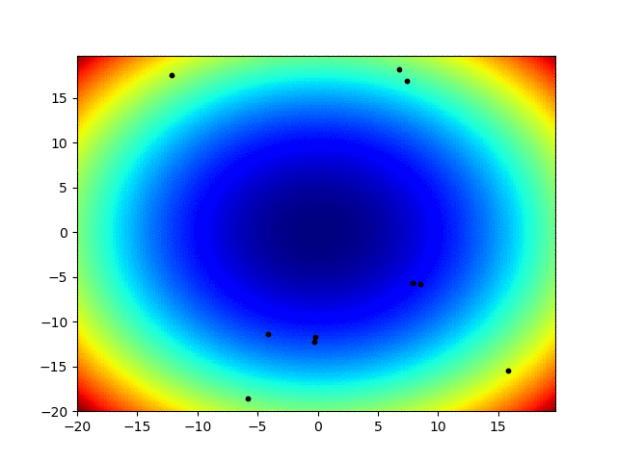
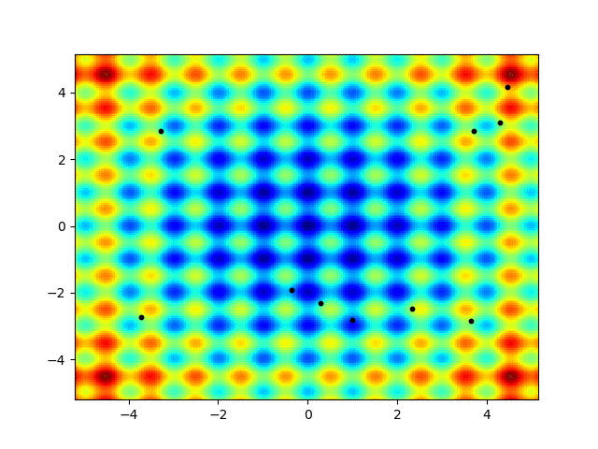
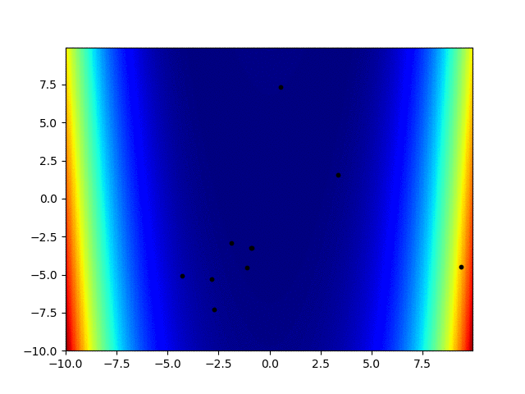
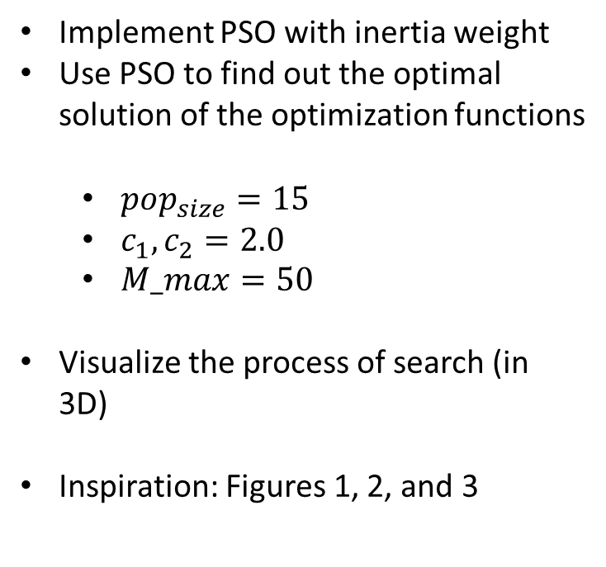
Task
Implement PSO with inertia weight
Use PSO to find out the optimal solution of the optimization functions
$pop_{size}=15$
$c_{1}, c_{2}=2.0$
$M_max=50$
Visualize the process of search (in 3D)
Inspiration: Figures 1, 2, and 3
Figure 2
Figure 1
Figure 3

Slide 10
Thank you for your attention
Ing. Lenka Skanderová, Ph.D.
EA 407
+420 597 325 967
lenka.skanderova@vsb.cz
homel.vsb.cz/~ska206

